Slide 1
Ion temperature imaging in the divertor of the W7-X stellarator using coherence imaging spectroscopy
Matt Kriete¹
V. Perseo², D. Gradic², D.A. Ennis¹, R. König², D.A. Maurer¹, and the W7-X Team²
¹Auburn University
²Max Planck Institute for Plasma Physics
High Temperature Plasma Diagnostics Conference
April 22, 2024
This work has been funded by US DoE grant DE-SC0014529. This work has been carried out within the framework of the EUROfusion Consortium, funded by the European Union via the Euratom Research and Training Programme (Grant Agreement No 101052200 -- EUROfusion). Views and opinions expressed are however those of the author(s) only and do not necessarily reflect those of the European Union or the European Commission. Neither the European Union nor the European Commission can be held responsible for them.

Slide 2
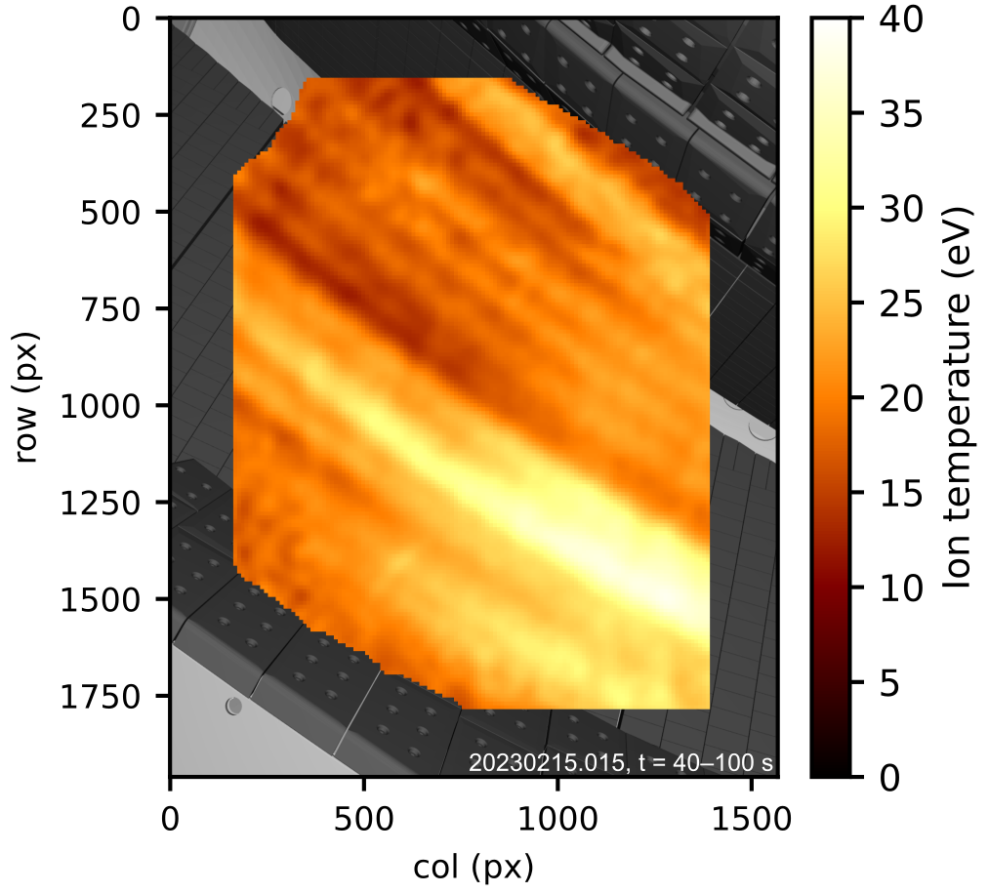
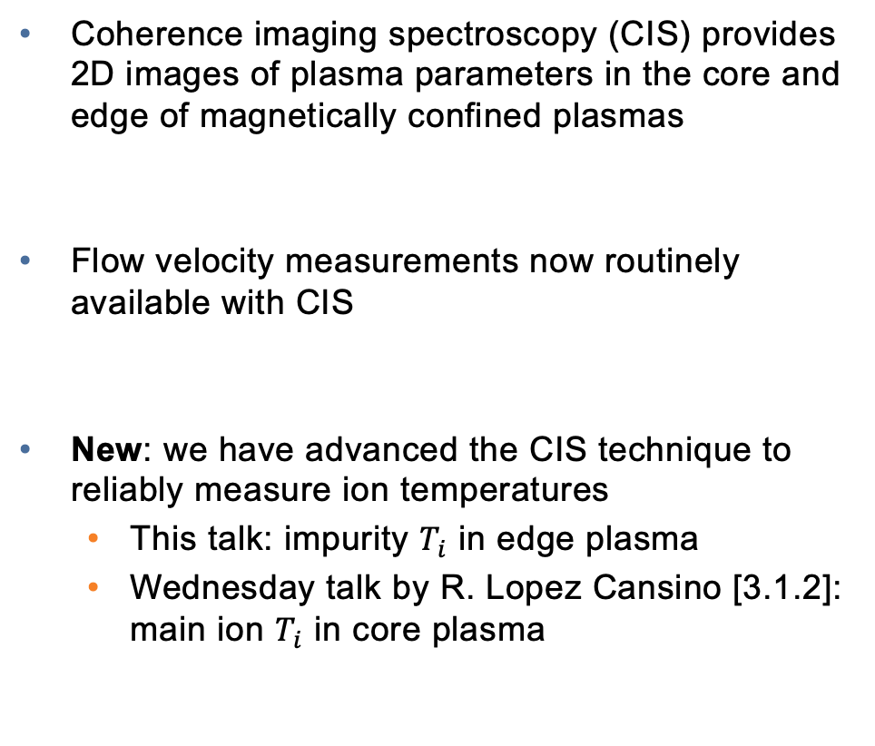
The coherence imaging spectroscopy technique has been advanced to image impurity ion temperatures
C²⁺ temperature distribution near lower divertor in W7-X
Coherence imaging spectroscopy (CIS) provides 2D images of plasma parameters in the core and edge of magnetically confined plasmas
Flow velocity measurements now routinely available with CIS
New: we have advanced the CIS technique to reliably measure ion temperatures
  This talk: impurity $T_{i}$ in edge plasma
  Wednesday talk by R. Lopez Cansino [3.1.2]: main ion $T_{i}$ in core plasma

Slide 3
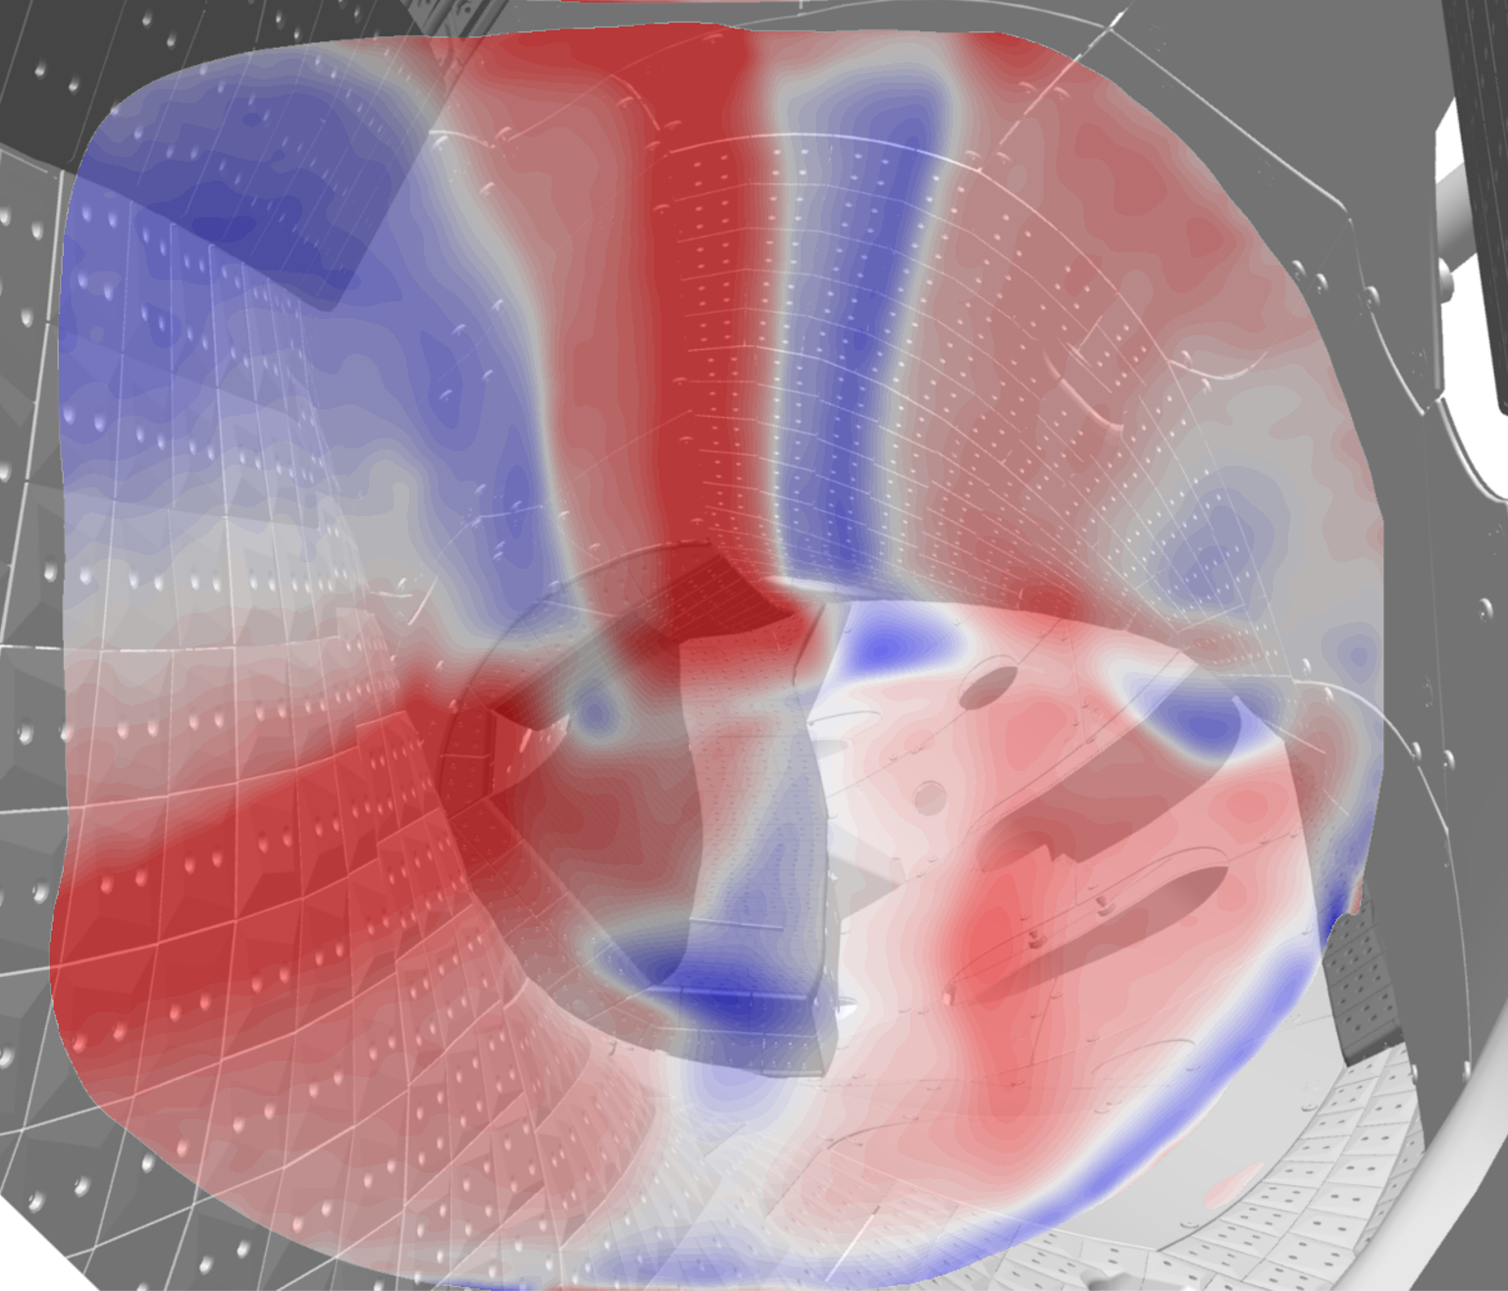
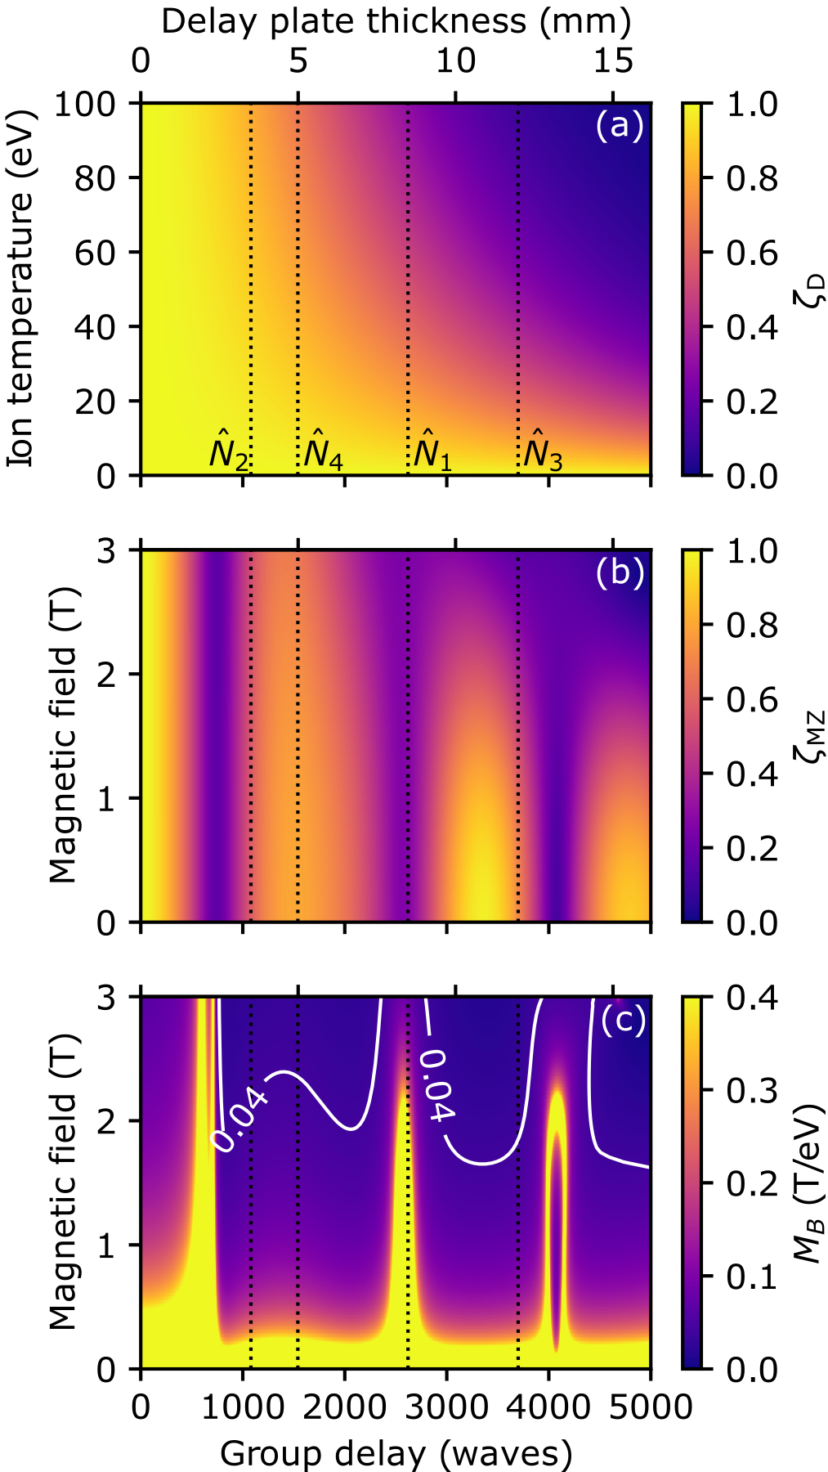
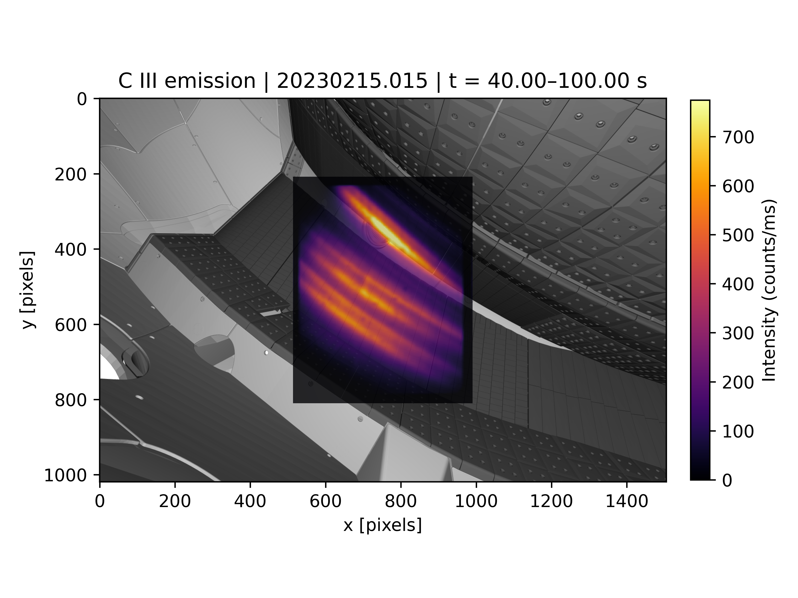
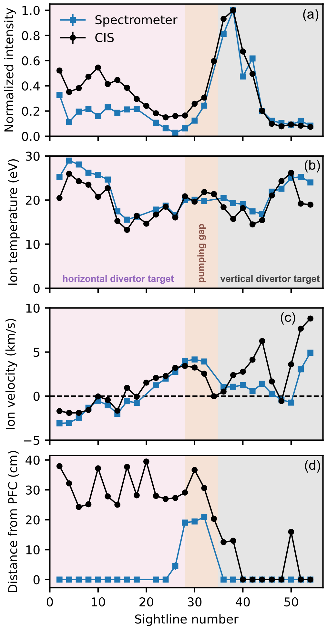

Outline
Motivation and overview of coherence imaging spectroscopy
CIS design principles for edge $T_{i}$ measurements
Inference of $T_{i}$ from CIS data
Validation of CIS $T_{i}$ measurements on W7-X

Slide 4

Outline
Motivation and overview of coherence imaging spectroscopy
CIS design principles for edge $T_{i}$ measurements
Inference of $T_{i}$ from CIS data
Validation of CIS $T_{i}$ measurements on W7-X

Slide 5
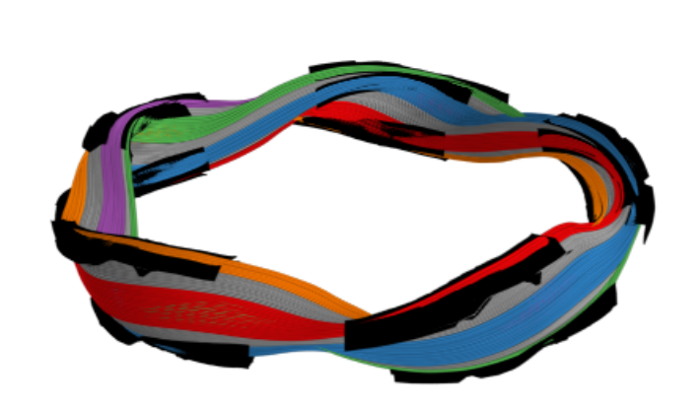
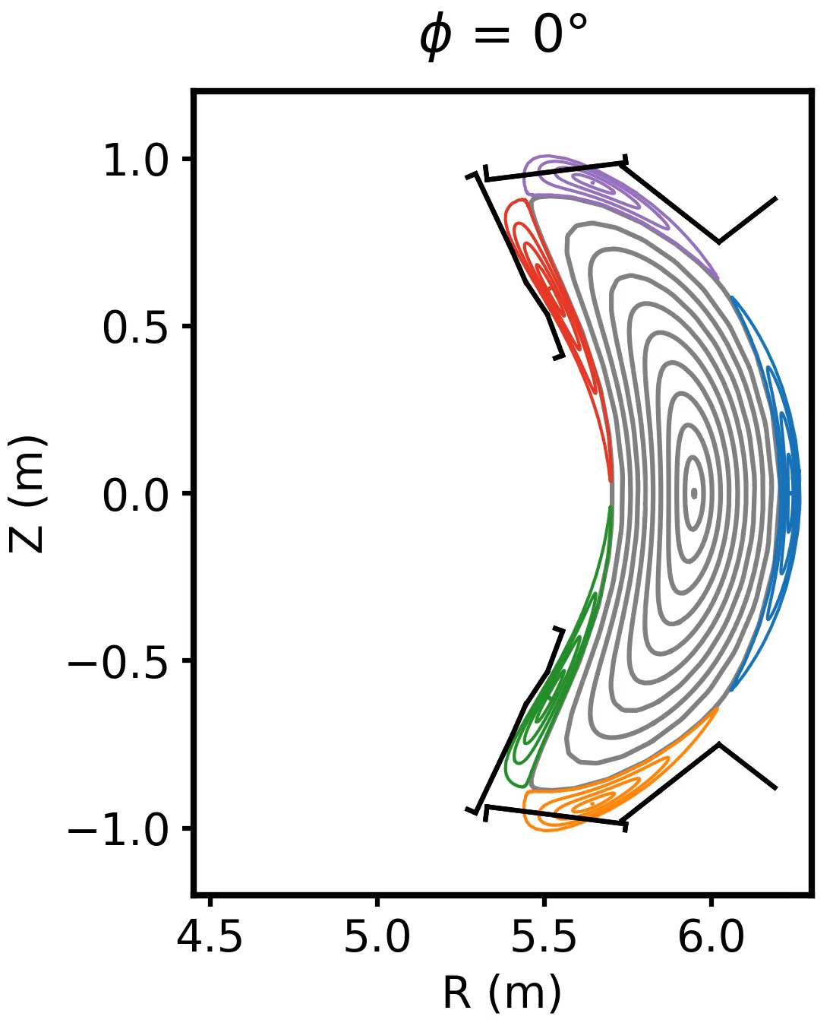
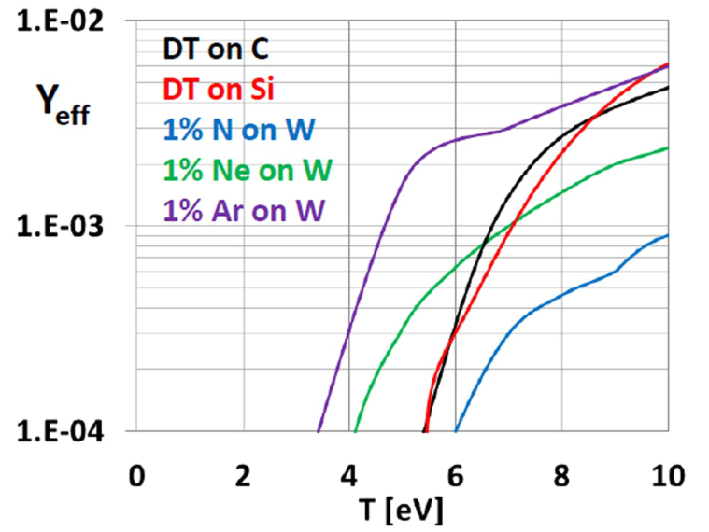
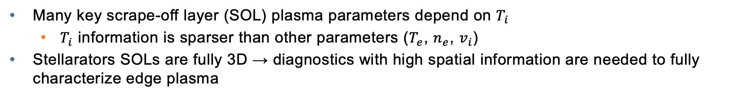
Images of edge ion temperature provide crucial information for understanding stellarator divertor physics
Many key scrape-off layer (SOL) plasma parameters depend on $T_{i}$
  $T_{i}$ information is sparser than other parameters ($T_{e}$, $n_{e}$, $v_{i}$)
Stellarators SOLs are fully 3D → diagnostics with high spatial information are needed to fully characterize edge plasma
W7-X SOL consists of magnetic islands intersected by divertor targets
Physical sputtering yield strongly depends on divertor ion temperature
0°
72°
P.C. Stangeby, PPFC 60 044022 (2018)
Notes:
Can mention a few edge plasma parameters that depend on Ti: divertor erosion rates, ion sound speed, sheath heat transmission factor

Slide 6
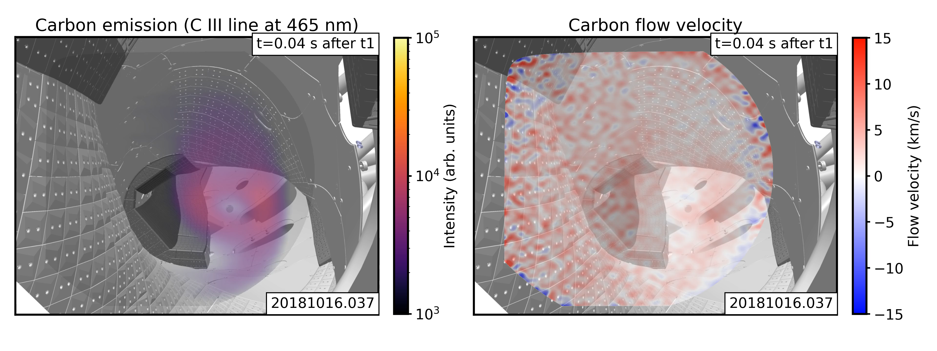
Coherence imaging spectroscopy is an established diagnostic for impurity emission and velocity measurements
Coherence imaging spectrometer (CIS) compared to dispersive spectrometer:
  CIS obtains substantially more spatial information
  CIS has ~100x higher optical throughput (no slit required)
  CIS collects substantially less spectral information → requires isolated spectral line
V. Perseo et al, NF 59 124003 (2019)

Slide 7
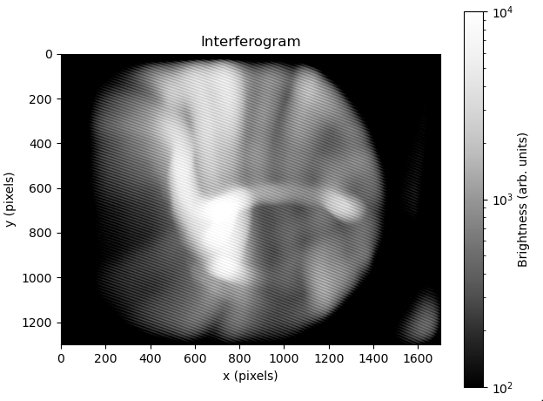
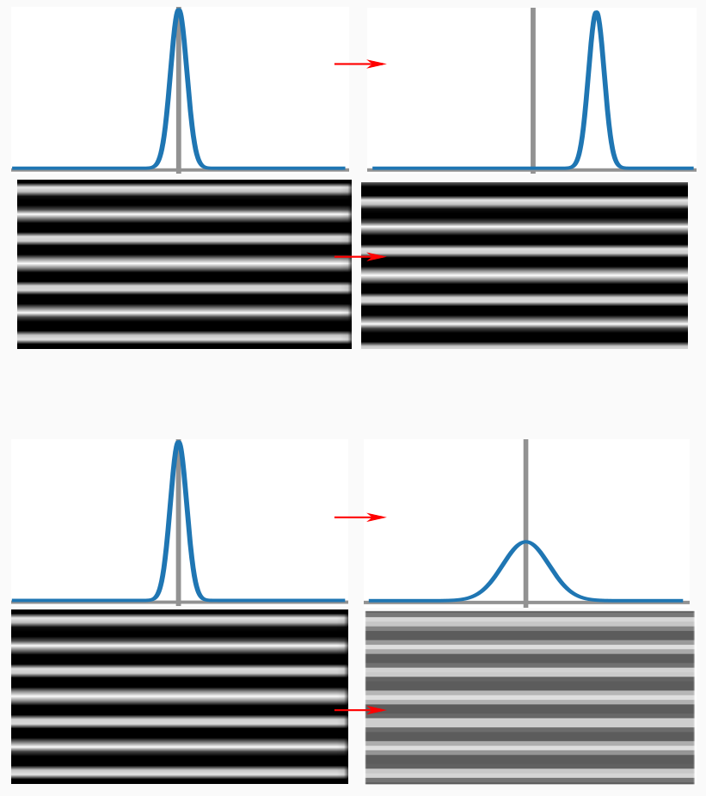



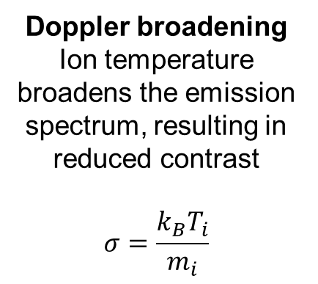
CIS encodes Doppler information from spectral emission lines into a spatial interference pattern
Interferogram (raw data)
Doppler shift
Ion velocity shifts wavelength of the emission line, resulting in a shift of the interference pattern
$$\frac{∆λ}{λ_{0}}=\frac{v_{i}}{c}$$
$$Δλ$$
$$λ_{0}$$
demodulation + calibration
Ion velocity (processed data)
Doppler broadening
Ion temperature broadens the emission spectrum, resulting in reduced contrast
$$σ=\frac{k_{B}T_{i}}{m_{i}}$$
$$2σ$$
[Figure courtesy N. Allen]

Slide 8
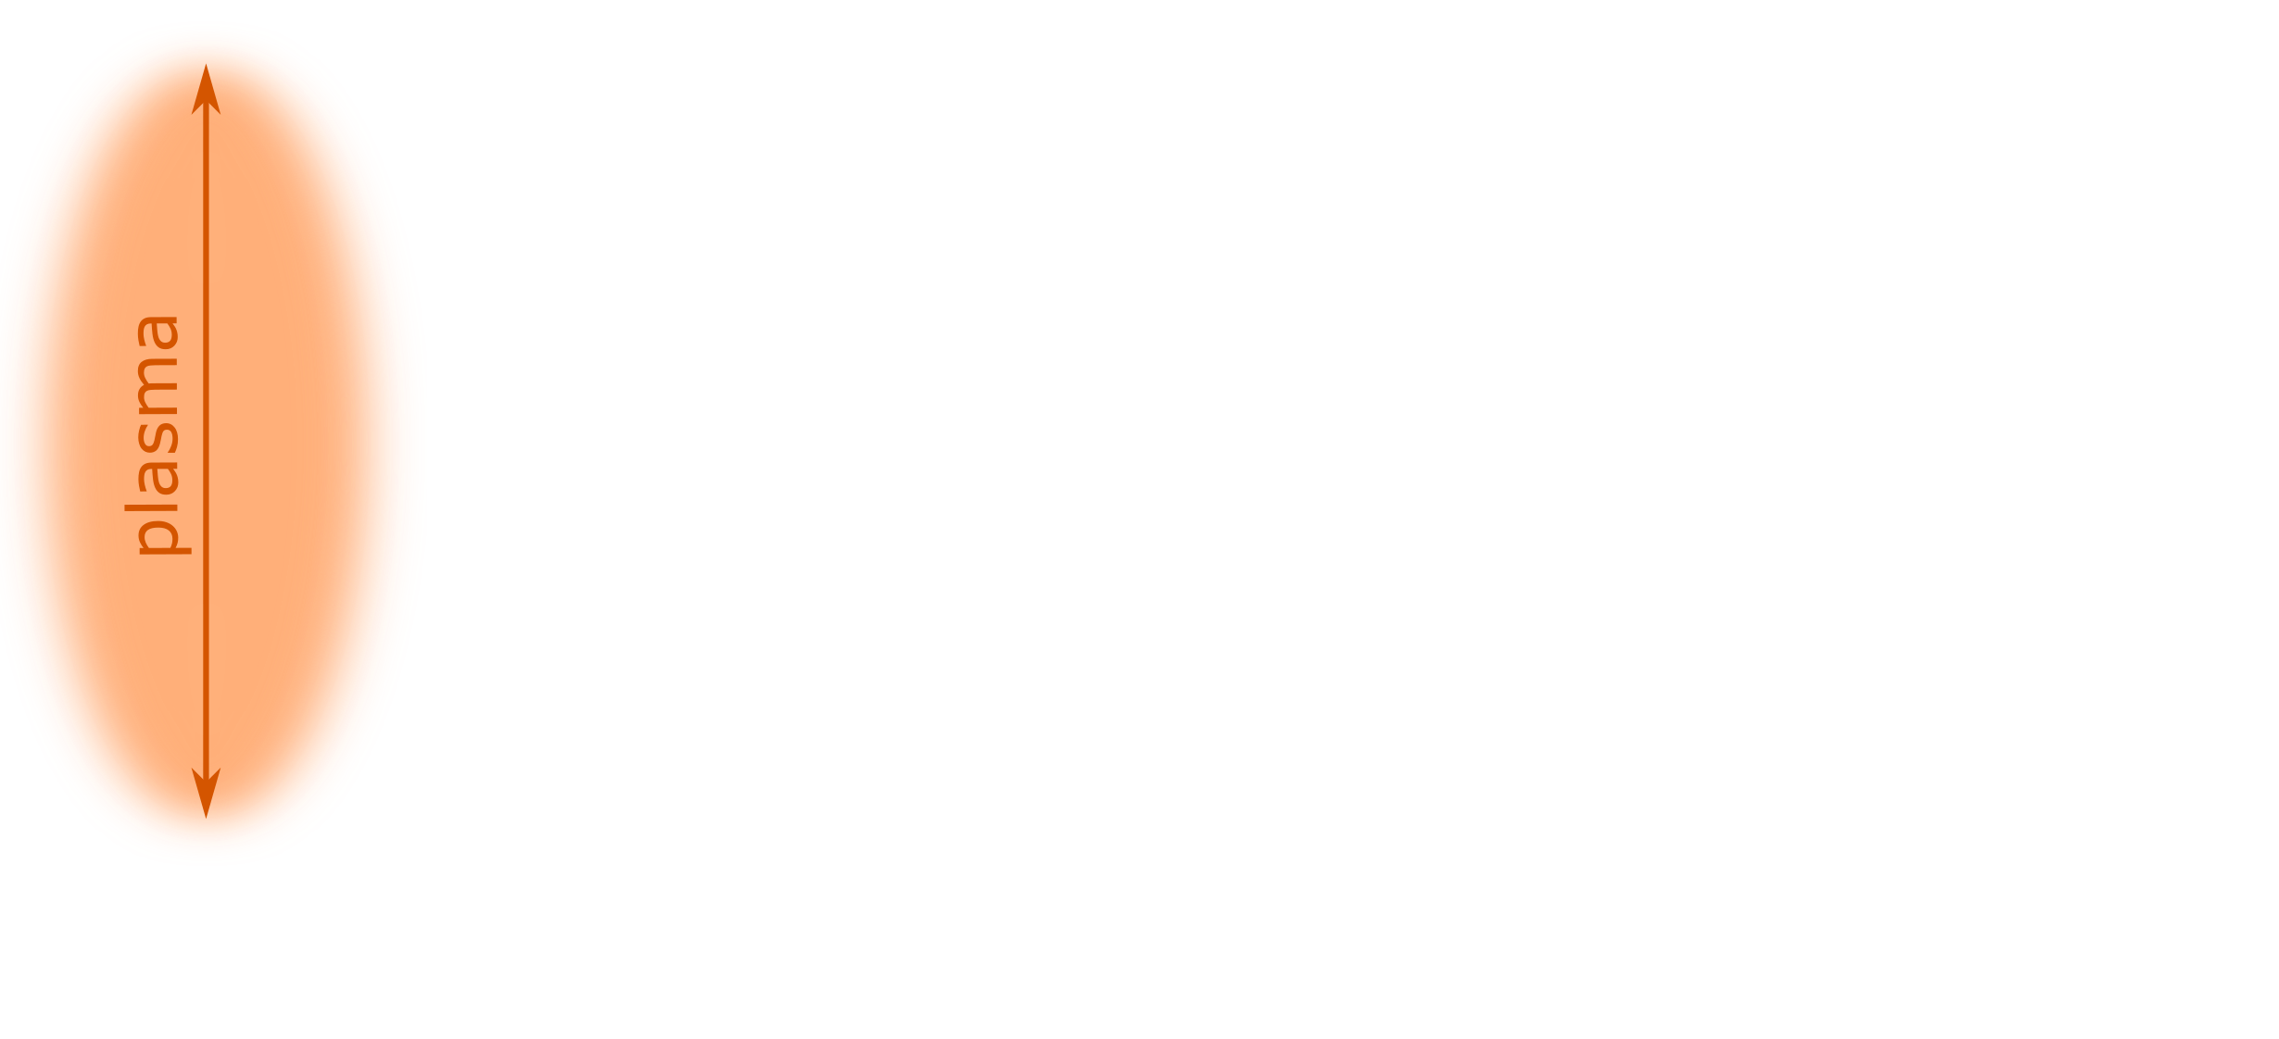
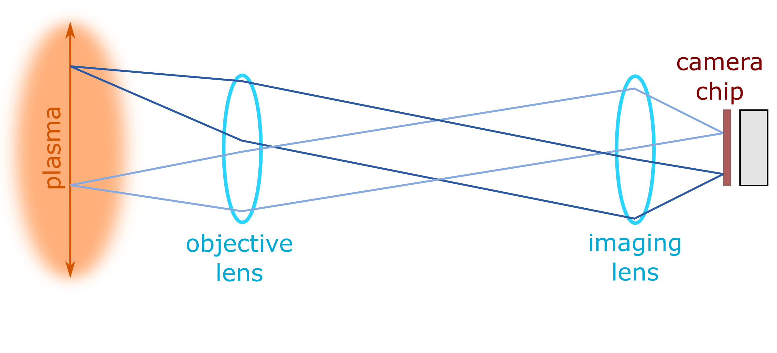
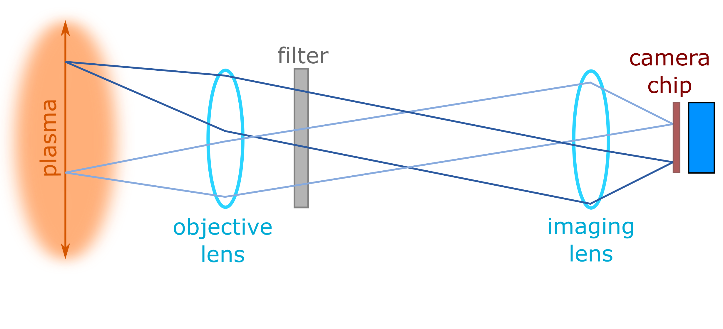
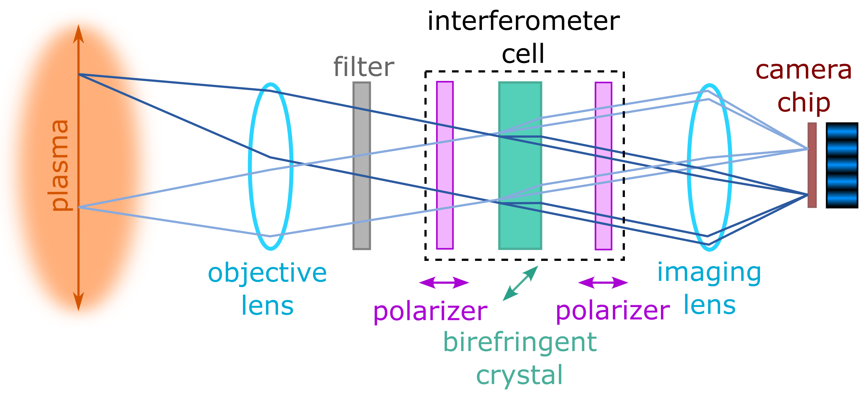
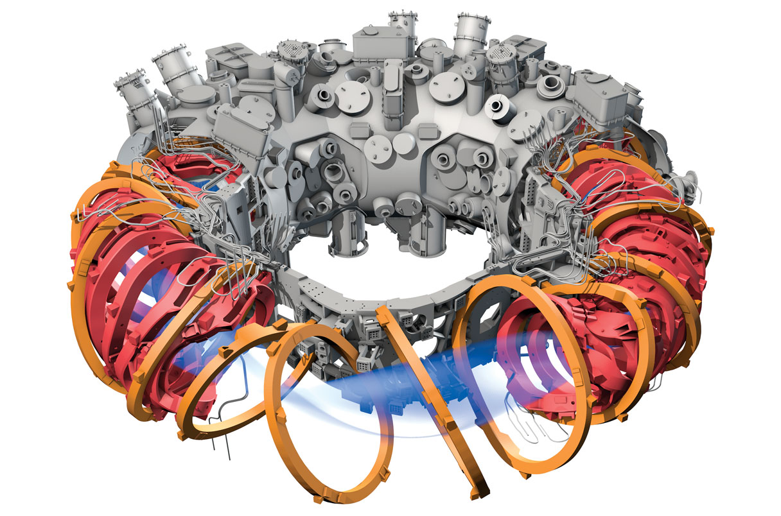
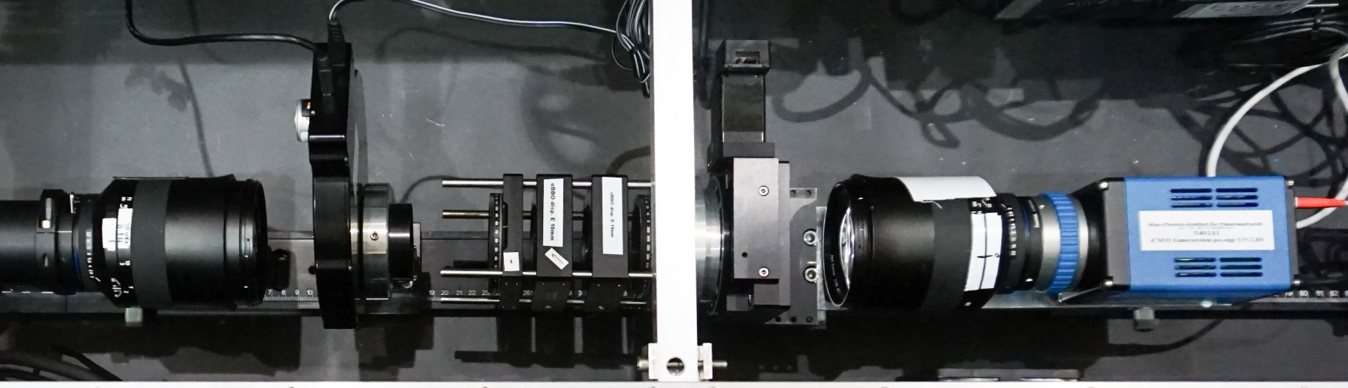
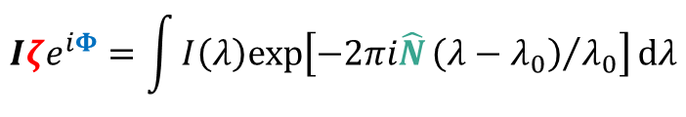
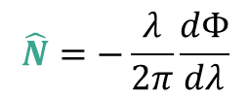
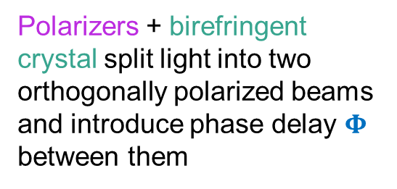
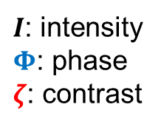
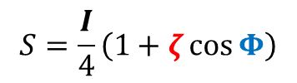
Interference pattern formed by imaging plasma light through a polarization interferometer
Polarizers + birefringent crystal split light into two orthogonally polarized beams and introduce phase delay $Φ$ between them
$I$: intensity
$Φ$: phase
$ζ$: contrast
$$S=\frac{I}{4}\left(1+ζ\cos{Φ}\right)$$
$$Iζe^{iΦ}=\int{I\left(λ\right)\text{exp}\left[−2πi\hat{N}{\left(λ−λ_{0}\right)}/{λ_{0}}\right]}dλ$$
Instrument sensitivity given by group delay:
$$\hat{N}=−\frac{λ}{2π}\frac{dΦ}{dλ}$$
imaging fiber bundle
V. Perseo et al, RSI 91 013501 (2020)
Notes:
Rework this to use animations to break this up (and include pictures of actual hardware is shown in addition to schematics + maybe polarization state of light at each stage?)

Slide 9

Outline
Motivation and overview of coherence imaging spectroscopy
CIS design principles for edge $T_{i}$ measurements
Inference of $T_{i}$ from CIS data
Validation of CIS $T_{i}$ measurements on W7-X

Slide 10
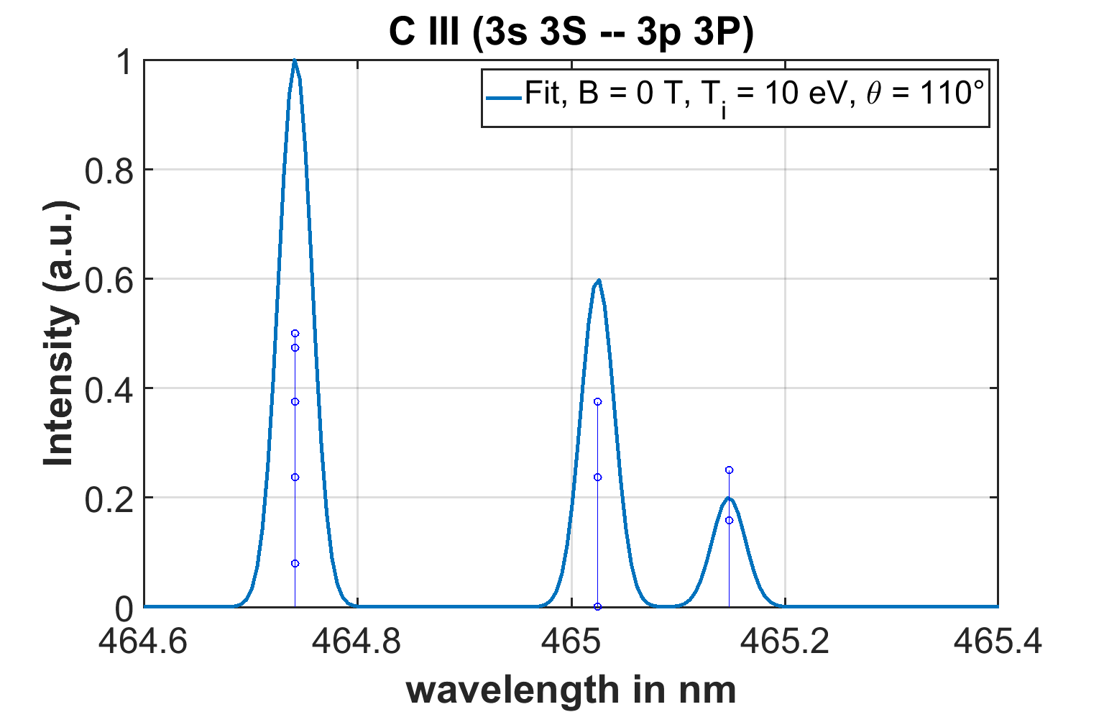
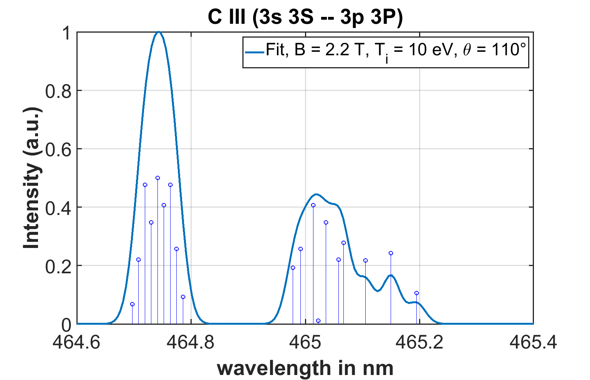
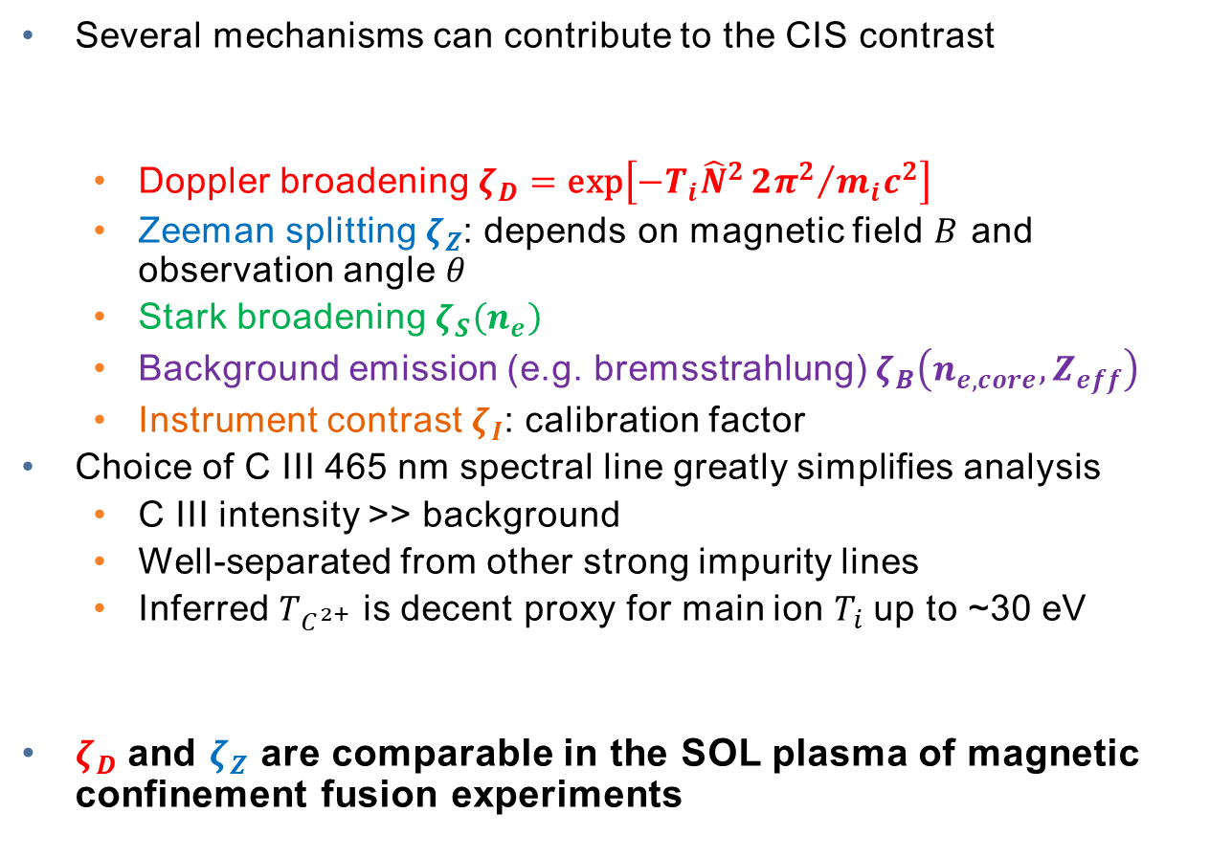


Main challenge measuring edge $T_{i}$ with CIS is distinguishing between Doppler broadening and Zeeman splitting
Several mechanisms can contribute to the CIS contrast
  Doppler broadening $ζ_{D}=\text{exp}\left[−T_{i}{\hat{N}}^{2}{2π^{2}}/{m_{i}c^{2}}\right]$
  Zeeman splitting $ζ_{Z}$: depends on magnetic field $B$ and observation angle $θ$
  Stark broadening $ζ_{S}\left(n_{e}\right)$
  Background emission (e.g. bremsstrahlung) $ζ_{B}\left(n_{e,core},Z_{eff}\right)$
  Instrument contrast $ζ_{I}$: calibration factor
Choice of C III 465 nm spectral line greatly simplifies analysis
  C III intensity >> background
  Well-separated from other strong impurity lines
  Inferred $T_{C^{2+}}$ is decent proxy for main ion $T_{i}$ up to ~30 eV
$ζ_{D}$and $ζ_{Z}$ are comparable in the SOL plasma of magnetic confinement fusion experiments
C III 465 nm line shape
$$ζ=ζ_{D}ζ_{Z}{ζ_{S}ζ}_{B}ζ_{I}$$
B = 0 T
T_{i} = 10 eV
B = 2.2 T
T_{i} = 10 eV
$$ζ≈ζ_{D}ζ_{Z}ζ_{I}$$
D. Gradic et al, NF 61 106041 (2021)

Slide 11
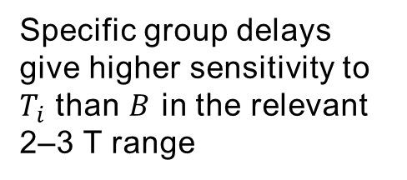
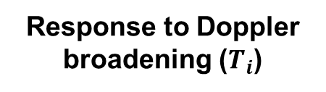
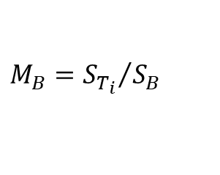


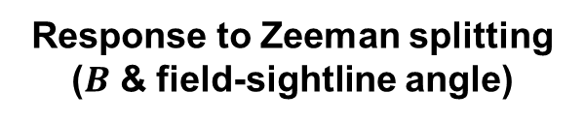
CIS birefringent crystals are optimized to minimize sensitivity to Zeeman splitting of C III 465 nm line
Response to Doppler broadening ($T_{i}$)
Response to Zeeman splitting ($B$ & field-sightline angle)
Relative sensitivity to Doppler vs Zeeman
$$S_{T_{i}}=\frac{1}{ζ_{D}}\frac{\text{d}ζ_{D}}{\text{d}T_{i}}$$
$$S_{B}=\frac{1}{ζ_{MZ}}\frac{\text{d}ζ_{MZ}}{\text{d}B}$$
$$M_{B}={S_{T_{i}}}/{S_{B}}$$
Sensitivity to multiplet + Zeeman splitting has non-monotonic group delay dependence → certain group delays give low Zeeman splitting sensitivity
Specific group delays give higher sensitivity to $T_{i}$ than $B$ in the relevant 2–3 T range
Sensitivity to Doppler broadening increases monotonically with increasing group delay
2620 waves chosen

Slide 12
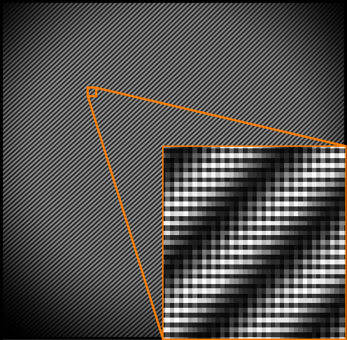
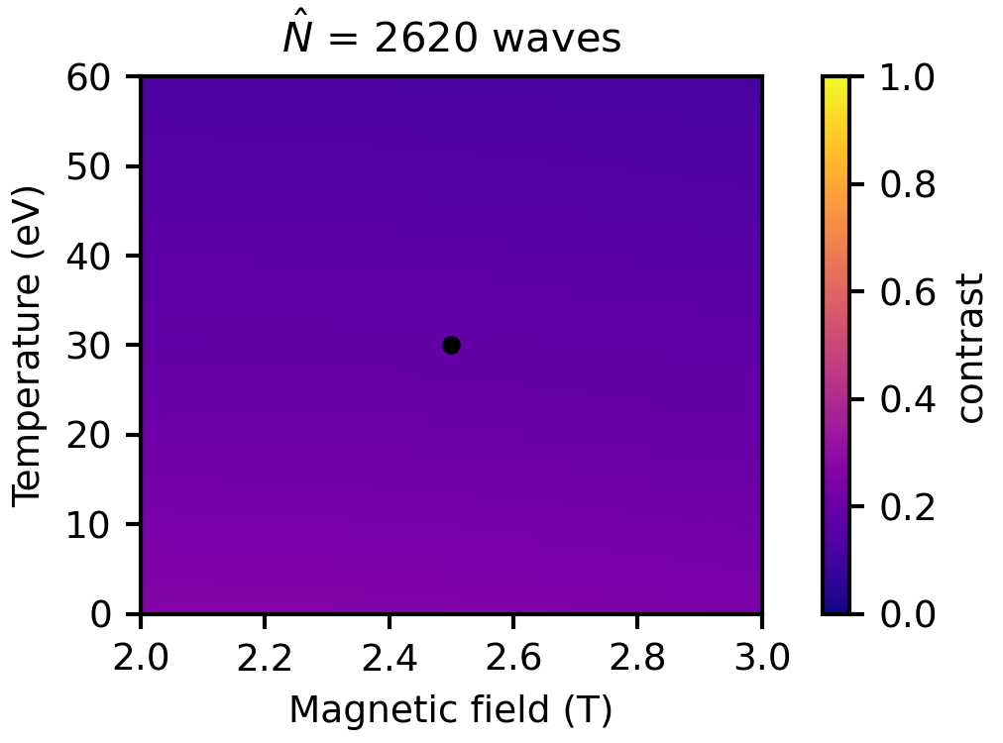
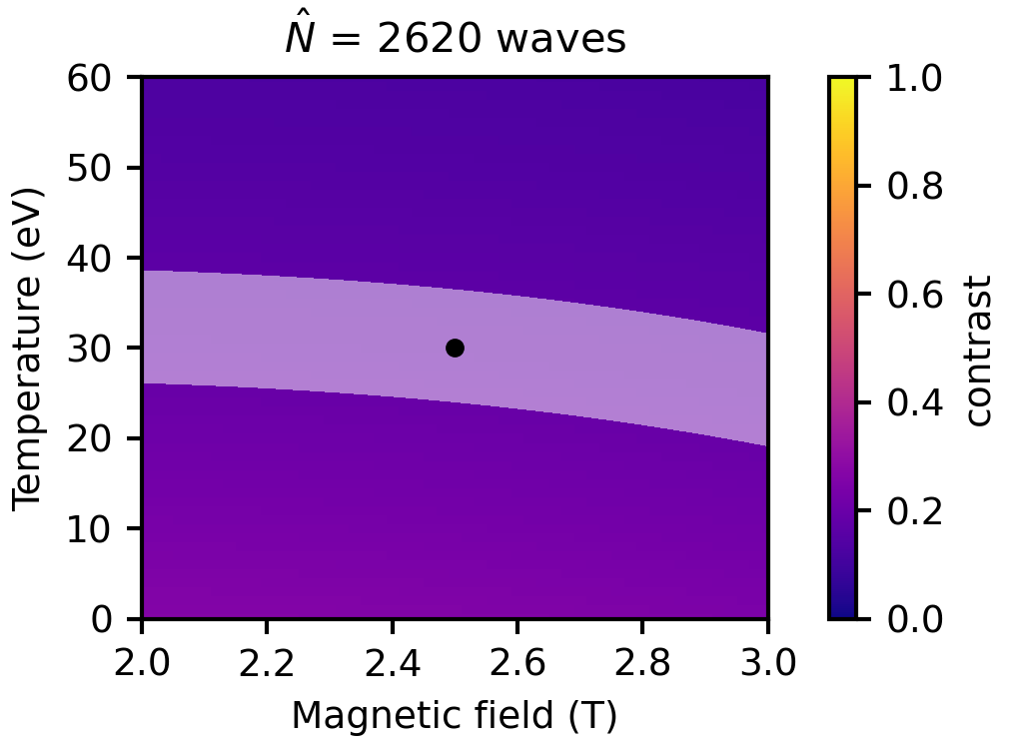
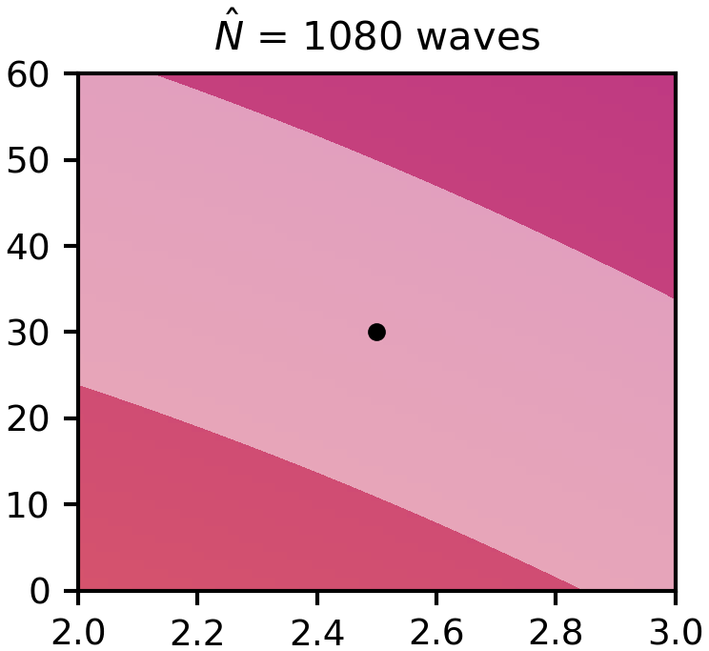
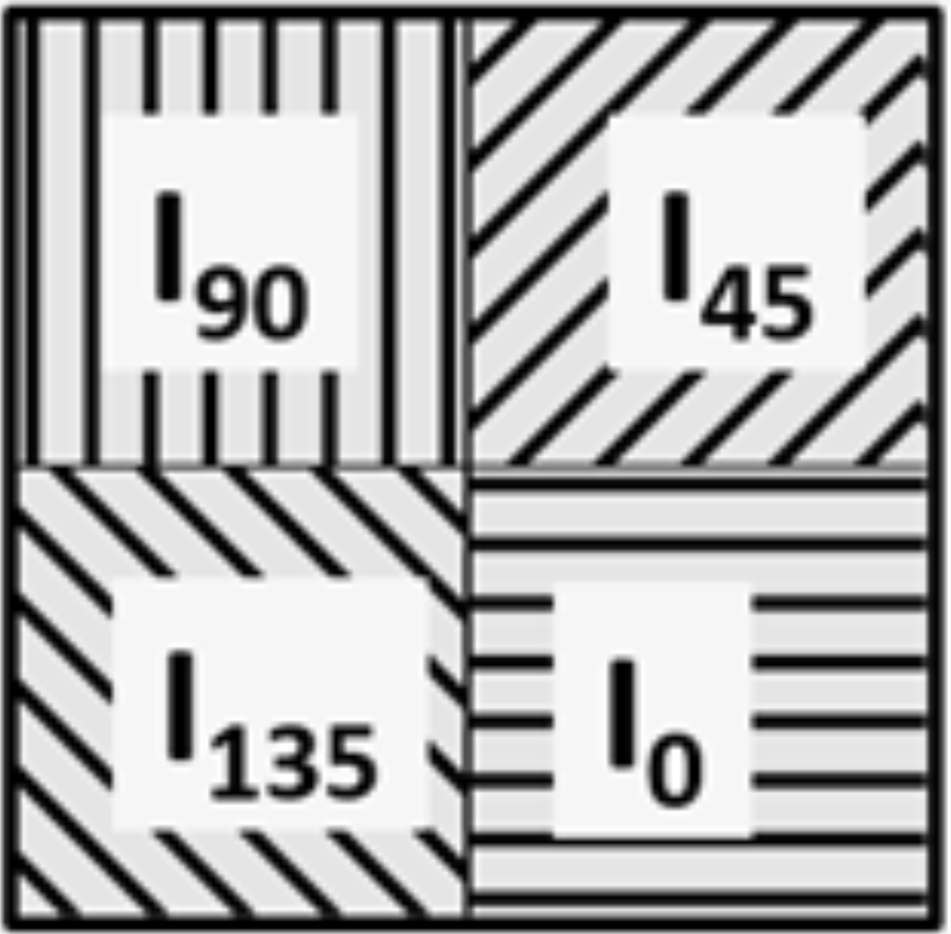
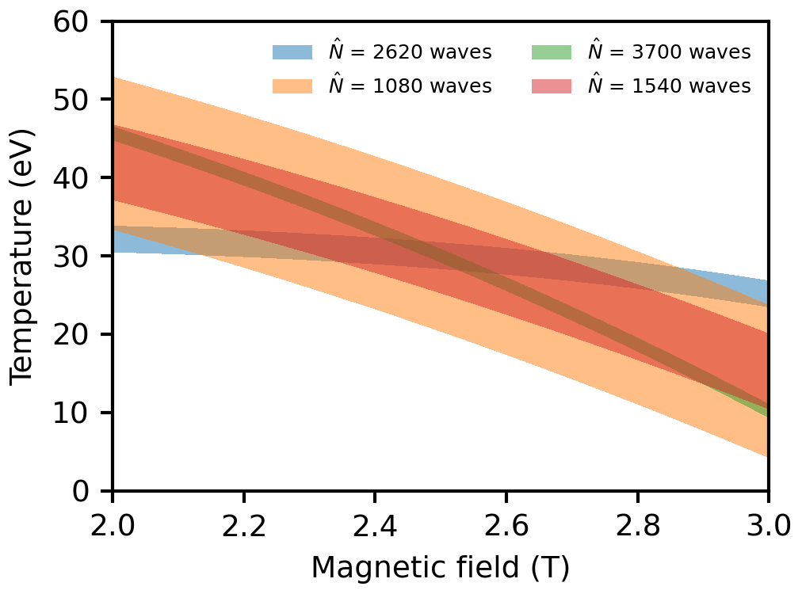
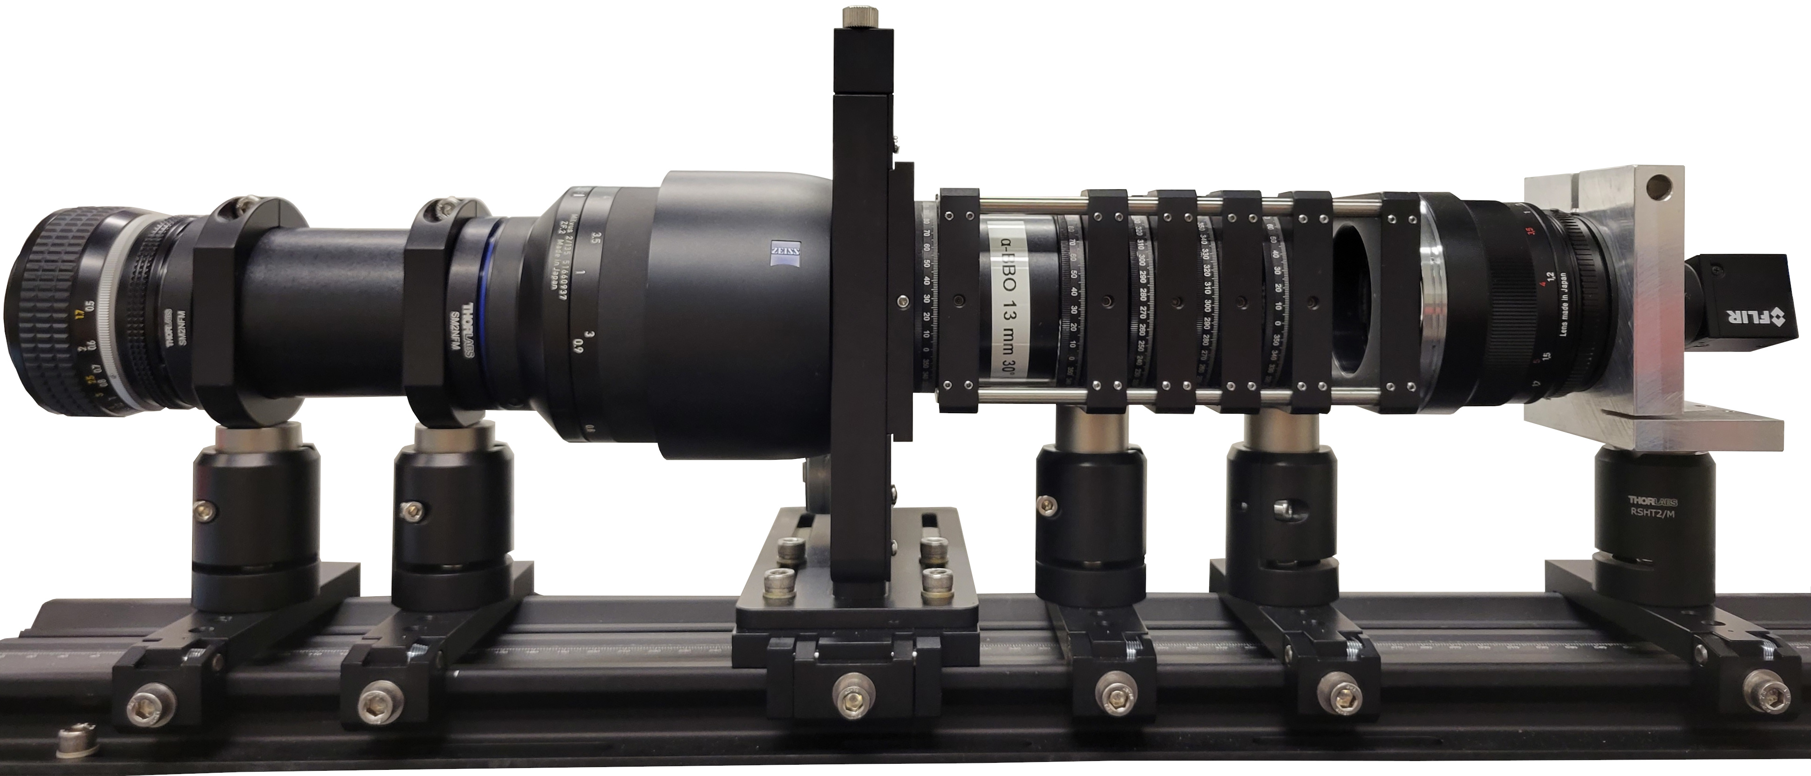

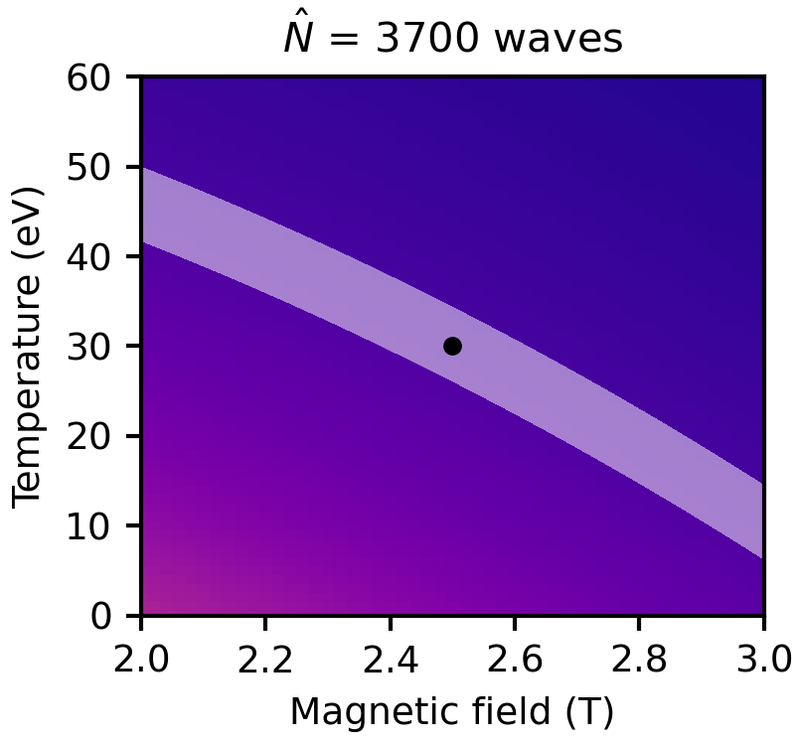
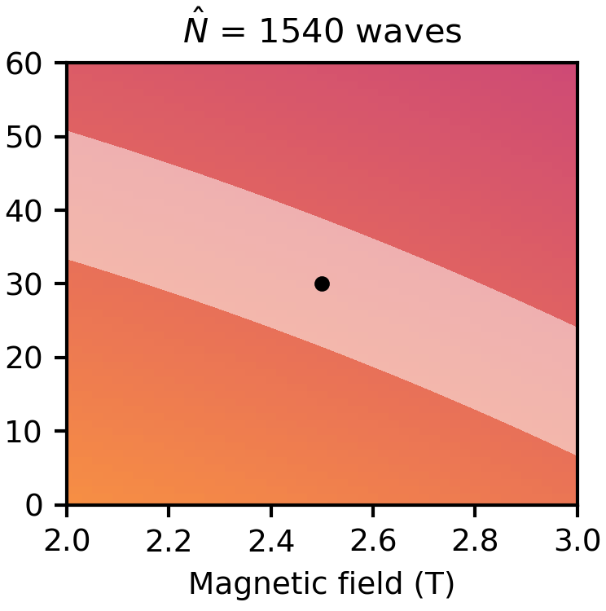
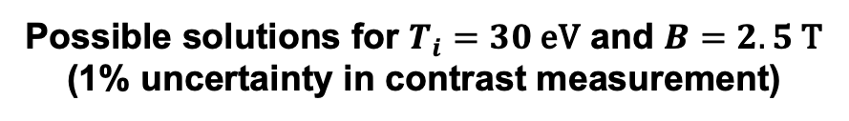
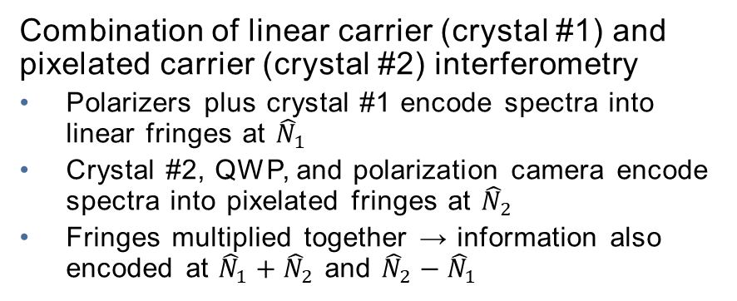
Multi-delay CIS approach increases the available spectral information, improving $T_{i}$ measurement accuracy
Possible solutions for $T_{i}=30 \text{eV}$ and $B=2.5 \text{T}$ (1% uncertainty in contrast measurement)
Multi-delay CIS approach¹ obtains spectral information at 4x as many delays as conventional CIS
Multi-delay fringe pattern
Micropolarizer grid
Filter wheel
Polarizer #1
Polarizer #2
Camera with micropolarizer sensor
Crystal #1 (displacer)
Crystal #2 (delay)
Collimating lens
Quarter-wave plate
Camera lens
Combination of linear carrier (crystal #1) and pixelated carrier (crystal #2) interferometry
Polarizers plus crystal #1 encode spectra into linear fringes at ${\hat{N}}_{1}$
Crystal #2, QWP, and polarization camera encode spectra into pixelated fringes at ${\hat{N}}_{2}$
Fringes multiplied together → information also encoded at ${\hat{N}}_{1}+{\hat{N}}_{2}$ and ${\hat{N}}_{2}−{\hat{N}}_{1}$
solution space using information from all four group delays
¹J.S. Allcock et al., RSI 92 073506 (2021)

Slide 13
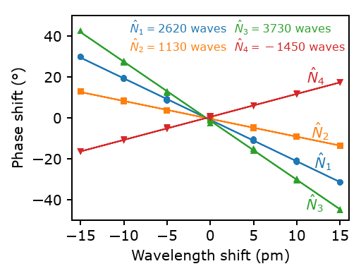
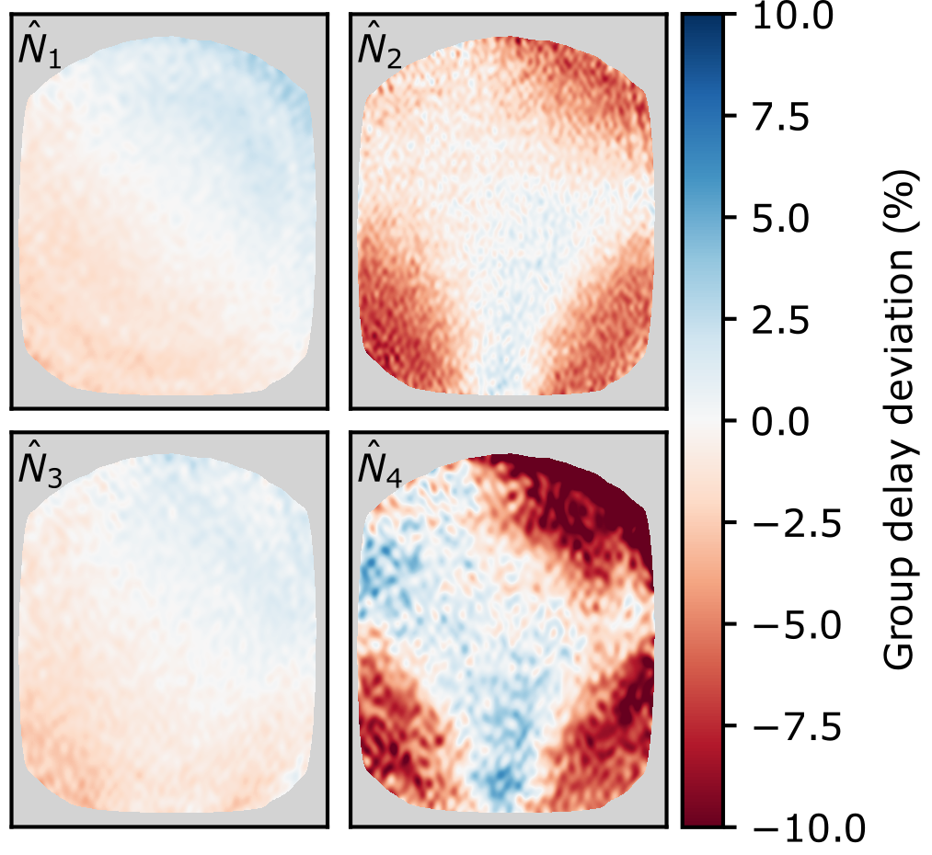
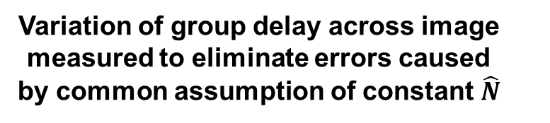
Multi-delay CIS instrument characterized and calibrated using precision tunable laser
Group delay measured using fine wavelength scans of precision tunable C-WAVE laser^{1,2}
Variation of group delay across image measured to eliminate errors caused by common assumption of constant $\hat{N}$
All group delays within 5% of design value
For more details on laser scans, see posters by V. Perseo [1.2.30] and S. Ahkundzada [1.4.26]
¹D. Gradic et al., FED 146 995 (2019)
²V. Perseo et al., RSI 91 013501 (2020)
Notes:
Sapida Ahkundzada

Slide 14

Outline
Motivation and overview of coherence imaging spectroscopy
CIS design principles for edge $T_{i}$ measurements
Inference of $T_{i}$ from CIS data
Validation of CIS $T_{i}$ measurements on W7-X

Slide 15



Magnetic field geometry is precisely known along CIS sightlines
W7-X stellarator optimized for low plasma current
→ magnetic field generated largely be external coils and easy to calculate along CIS sightlines
toroidal direction

Slide 16

















Temperature is inferred by fitting a model of the C III line shape to data, using variation of magnetic field along sightlines
Data: phase and contrast images for each of
the four group delays
Fitting model: C III 465 nm triplet with Doppler
shift/broadening and Zeeman splitting
C III emission localized to a single 1-5 cm long
region in SOL near divertor^{1,2} → $B$ and $θ$ are
not independent fit parameters
Fit parameters:
C²⁺ velocity $v_{i}$
C²⁺ temperature $T_{i}$
Distance of emission location along sightline $d_{sightline}$
Magnetic field known along sightlines
→ $B=B\left(d_{sightline}\right)$, $θ=θ\left(d_{sightline}\right)$
$B$ and $θ$ for example sightlines
Tomographic reconstructions of C III radiation distribution²
Phase $Φ$
Contrast $ζ$
$${\hat{N}}_{1}$$
$${\hat{N}}_{2}$$
$${\hat{N}}_{1}$$
$${\hat{N}}_{2}$$
$$Φ−Φ_{cal}=Φ_{D}\left(v_{i}\right)+Φ_{MZ}\left(B,θ\right)$$
CIS viewing direction
$$ζ/{ζ_{I}}=ζ_{D}\left(T_{i}\right)ζ_{MZ}\left(B,θ\right)$$
$${\hat{N}}_{3}$$
$${\hat{N}}_{4}$$
$${\hat{N}}_{3}$$
$${\hat{N}}_{4}$$
¹D. Gradic et al., PPCF 64 075010 (2022)
²M. Krychowiak et al., EPS 2021 P1.1026

Slide 17

Outline
Motivation and overview of coherence imaging spectroscopy
CIS design principles for edge $T_{i}$ measurements
Inference of $T_{i}$ from CIS data
Validation of CIS $T_{i}$ measurements on W7-X

Slide 18








$T_{i}$-optimized CIS diagnostic is validated by cross-comparison with a high-resolution dispersive spectrometer
CIS C III intensity image in long-pulse W7-X plasma
CIS & spectrometer data averaged over a 60 s stationary time window → high signal-to-noise ratio
Direct comparison of CIS and spectrometer data requires Fourier transformation of spectrometer wavelength spectra into coherence spectra: $I\left(λ\right)→γ\left(\hat{N}\right)$
spectrometer fiber locations
spectrometer fiber locations
Spectrometer sightline 38
Spectrometer sightline 38
Fourier transform
$$γ=\frac{1}{I}\int{I\left(λ\right)}\exp\left[−2πi\hat{N}λ/{λ_{0}}\right]\text{d}λ$$
Contrast = $\left|γ\right|$
$γ$: coherence
$\hat{N}$: interferometer group delay
$λ_{0}$: center wavelength of line
$I\left(λ\right)$: intensity per unit wavelength
$I$: integrated line intensity
EJM007+2520

Slide 19


CIS and spectrometer measure same spectral information and fits are in good agreement for most sightlines
Highest signal
Most spectral contamination
Lowest spectrometer signal
spectrometer fiber locations
$J=0,1$ triplet components weighted 15% higher than statistical values due to strong electron impact excitation
[J.D. Hey et al., J. Phys. B 35 1525 (2002)]

Slide 20


Comparison between CIS and Sopra shows excellent agreement of C²⁺ temperatures
Do CIS and the spectrometer infer the same plasma parameters?
C²⁺ temperature comparison between CIS & spectrometer
C III intensity comparison between CIS & spectrometer
spectrometer fiber locations
vertical divertor target
pumping gap
Similar C III intensity profiles (difference in vignetting by plasma facing lens)
CIS & Sopra C²⁺ $T_{i}$ show excellent agreement:
  Well-matched profile shape
  ~10% difference on average
  25% difference in worst case
horizontal divertor target

Slide 21





Divertor ion temperature image shows toroidally elongated structures and inverse correlation between $T_{i}$ and C III radiation
C III intensity
C²⁺ ion temperature image
$T_{i}=10−40 \text{eV}$ over divertor
Regions of high C III emission have lower $T_{i}$ and vice-versa
Band with particular high $T_{i}$ (up to 40 eV)

Slide 22




Summary and outlook
CIS diagnostic technique has been advanced to image C²⁺ ion temperatures without requiring cross-calibration by a separate dispersive spectrometer
Temperature measurements enabled by multi-delay configuration and novel approach to designing CIS birefringent crystals that minimizes instrument sensitivity to Zeeman splitting
CIS C²⁺ $T_{i}$ measurements validated by comparison against high-resolution spectroscopy in W7-X
New measurement capability is being used to characterize SOL $T_{i}$ distribution across W7-X parameter space (example: density ramp to detachment)
Density ramp to detachment
C III intensity
C²⁺ temperature
20230214.042

